Slide 1

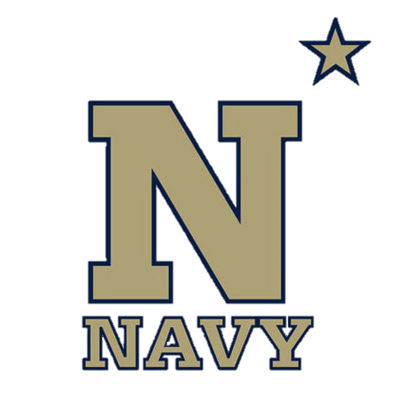
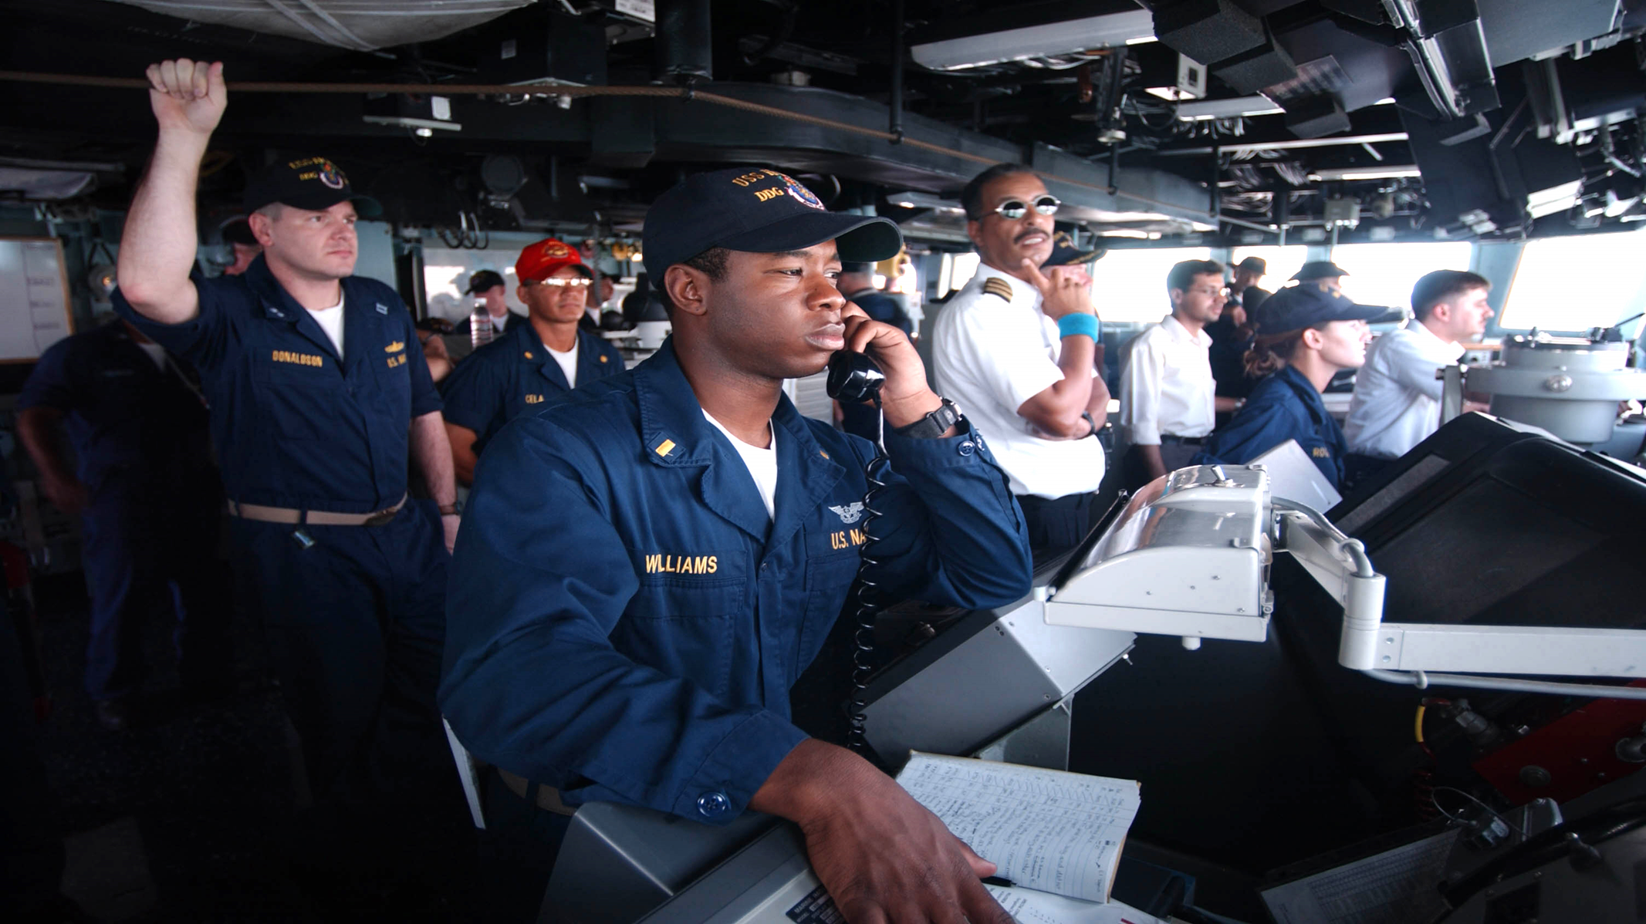
Bridge Resource Management
NN220-18
SEANAV I United States Naval Academy
NN220 – Fundamentals of Navigation– Updated May 2023
Operations Officer I HMS PROTECTOR A173 I The Ice Patrol Ship

Slide 2
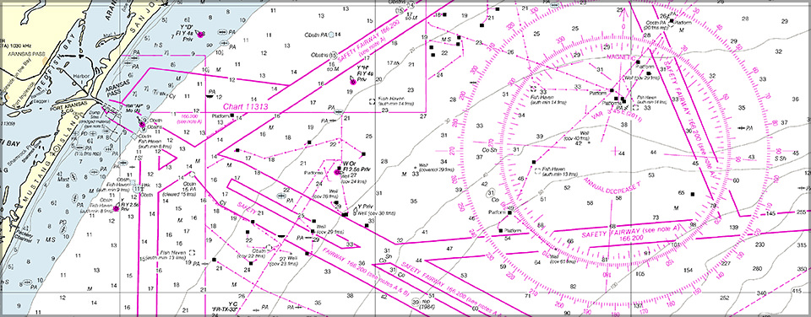
References
-The American Practical Navigator, Pub. No. 9, Bowditch, VOL. 1, 2019 Edition -Surface Ship Navigation Department Organizations and Regulations Manual (NAVDORM), COMNAVSURFPAC/COMNAVAIRPAC/COMNAVAIRLANT/COMNAVSURFLANT INSTRUCTION 3530.4 series -Mishap Case Study: USS PORTER (DDG 78), CS-05 -Navigation Rules, COMDTINST M16672.2 series -Operational Risk Management (ORM), OPNAVINST 3500.39 series -Scrubbed Afloat Safety Investigation Report on Collision in Strait, MSG DTG XXXXXXXZOCT12 (USS PORTER (DDG 78))
SEANAV I United States Naval Academy
NN220 – Fundamentals of Navigation
Operations Officer I HMS PROTECTOR A173 I The Ice Patrol Ship

Slide 3
Enabling Objectives
1 – IDENTIFY human factors that likely contribute to marine mishaps and methods to mitigate these factors. 2- APPLY applicable rules outlined in the Amalgamated International & U.S. Inland Navigation Rules which were & were not followed in the case study. https://www.navcen.uscg.gov/?pageName=NavRulesAmalgamated#Rule%2015 3 - DEFINE the error chain. 4 - DISCUSS how effective ORM could have mitigated the mishap. 5 - DETERMINE the Error Chain and the actions, decisions, and events that allowed a given mishap to develop. 6 - DISCUSS solutions that could prevent Error Chain progression. 7 - DISCUSS ways the bridge watch team can mitigate Error Chain progression from the bridge. 8 - APPLY the Error Chain Model to a Case Study. 9 - UTILIZE concepts learned in the course to determine mitigating factors to avoid an incident at sea.
SEANAV I United States Naval Academy
NN220 – Fundamentals of Navigation
Operations Officer I HMS PROTECTOR A173 I The Ice Patrol Ship

Slide 4
What is BRM?
BOWDITCH: “Bridge Resource Management” (BRM) is the study of the resources available to the navigator and the exploitation of them in order to conduct safe and efficient voyages.”
Term was adopted in the 1990’s by the Maritime Industry as an error management tool.
The Aviation Community has Crew (or Cockpit) Resource Management which entails the effective utilization of certain training procedures and resources for flight crews to ensure efficient flight operation.
BOTTOM LINE, BRM is now a fundamental part of Crew Training, playing an important role in environments where Human Error can have devastating effects.

Slide 5
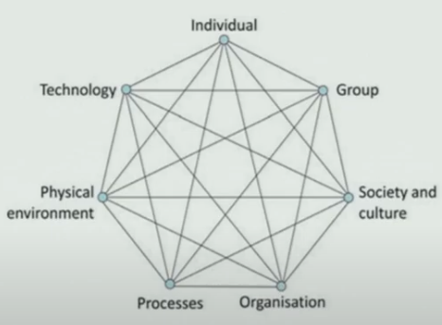
What is BRM (Cont’d)?
BRM is described as the effective management of all resources, Human and Technical, available to the Bridge Team to deliver the safe completion of the Mission.
Components Include:
Human Factors
Communication
Training
Decision Making
Fatigue
Technology

Slide 6
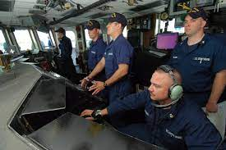
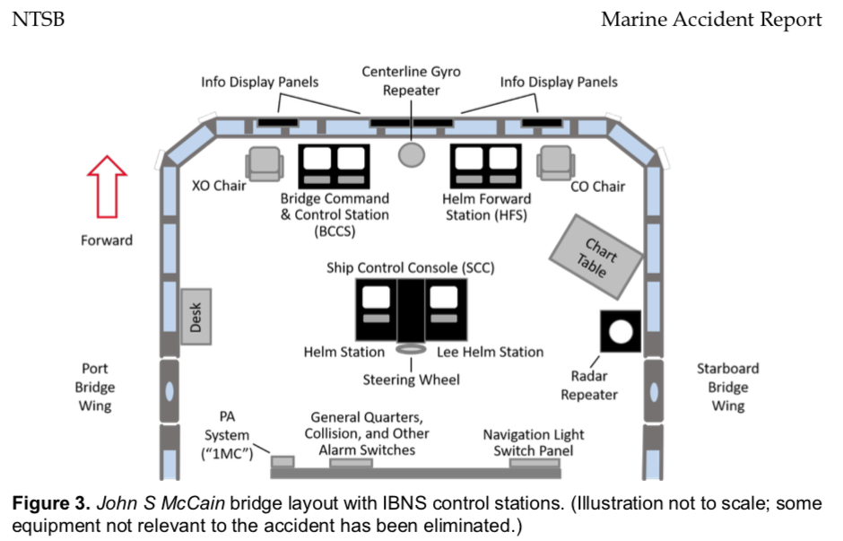
Components of BRM
Human Factors – In USN Warships, the Bridge Human environment is complex. There are numerous roles and relationships that must be understood that enable proper procedures to be executed.
Communication – Effective exchange of orders and information in a timely matter is critical to bridge environment.
Training – Training not just as the Individual, but as part of the Collective. How do we ensure people are prepared to execute the tasks assigned?
Training – Training not just as the Individual, but as part of the Collective. How do we ensure people are prepared to execute the tasks assigned?
Decision Making – From the CO to the OOD, and supporting outstations, poor decisions can have an immediate, dangerous impact. This includes everything from Anti-Collision to Shiphandling and tactical operations.

Slide 7
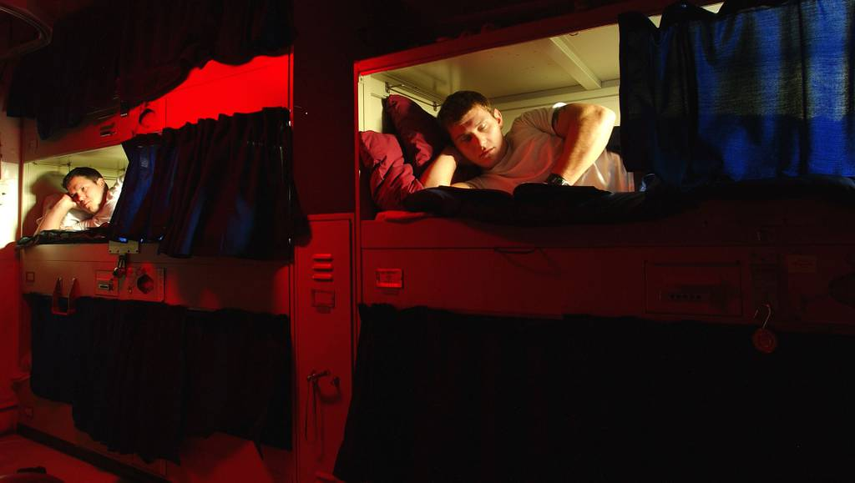
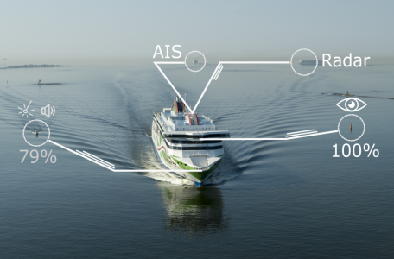
Components of BRM (Cont’d)
Fatigue – Especially in an operational environment, watch rotations can have a significant impact against cognitive ability. Just as in the aviation world, fatigue management of individuals must be considered.
Technology – Equipment can be a help or hinderance. It can support the team, providing timely information. The opposite is also true.
Teams must be able to manage all equipment effectively, whether sensors that enable detection, communications that enable us to talk or the propulsion, steering and generation systems that allow us to move.
They must be able to interrogate information – is the picture accurate? They must therefore avoid overreliance. Redundancies and alternative procedures must be understood and be available to be applied in event of a failure.

Slide 8
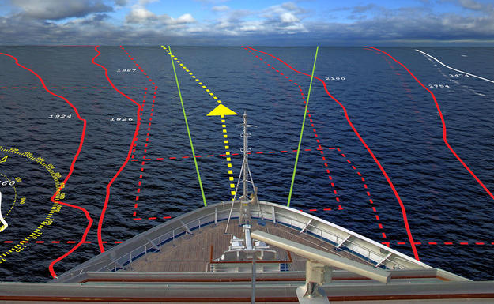
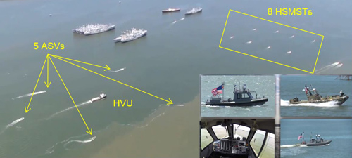
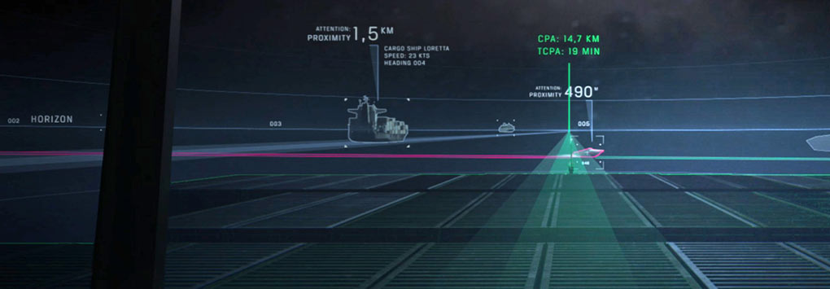
Components of BRM (Cont’d)
All of these factors contribute to maintaining Situational Awareness (SA).
Situational Awareness (SA) in the maritime and operational domains include:
Other ships and their proximity.
Are there Military vessels in the area?
Aircraft operations.
The effect from the environment – Wind / Current.
Threats.
Equipment; is it operating as designed?
Any loss of SA can result poor decision making that leads to collision, grounding or worse in aviation terms.

Slide 9
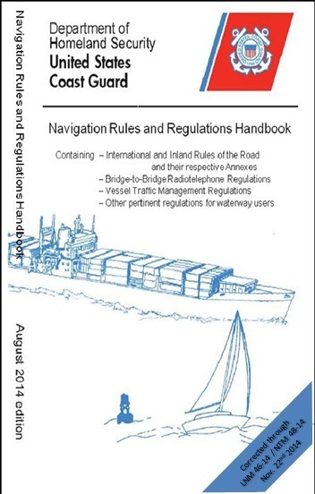
Components of BRM (Cont’d)
Knowledge and correct application of Rules of Road assists a Bridge Team prevent incidents at sea.
Anything short of confidence and/or incorrect or incomplete knowledge can cause hesitation and conflict on the Bridge and out on the waterways.
Experienced Bridge Teams, with good SA from the previously mentioned BRM factors, can recognize situations developing early and act early and/or quickly.

Slide 10
Criticality of BRM
Ship navigation is cognitively demanding.
Demands “Hard” skills (i.e. technical) and “Soft” skills (i.e. social, leadership, communication, teamwork, etc.) to safely operate.
Crew must manage and interact with differing systems (Not uncommon to find several differing brands and systems on a single Bridge).
Most transportation accidents caused by human error. Broad trends include:
Better decisions result from input by many individuals (no lone wolf).
Success or failure of a team depends on their ability to communicate and cooperate.
Effective teams can share workloads and reduce stress.
Effective teams usually catch mistakes before they happen, or soon after, and correct them

Slide 11
Understanding the Mission
Before we execute a Mission or Plan, we need to understand it. What factors impact the Mission?
What is the Mission?
What time is available? ETA/ETD?
What is the required Speed of Advance?
What are the expected environmental conditions?
What are the ephemerals? Day / Night / Tides?
What are my constraints? Equipment / Personnel / Training?
Have we assessed the Risk?
Have we briefed the Team?

Slide 12
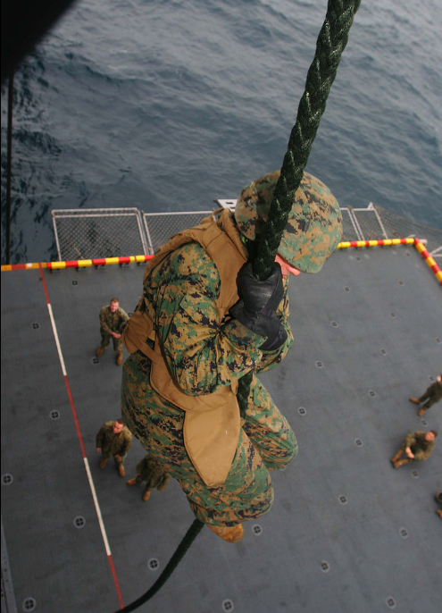
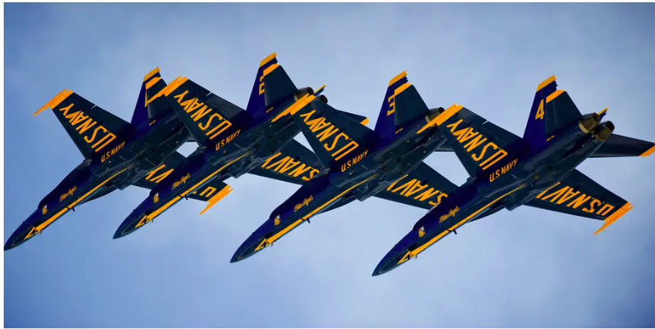
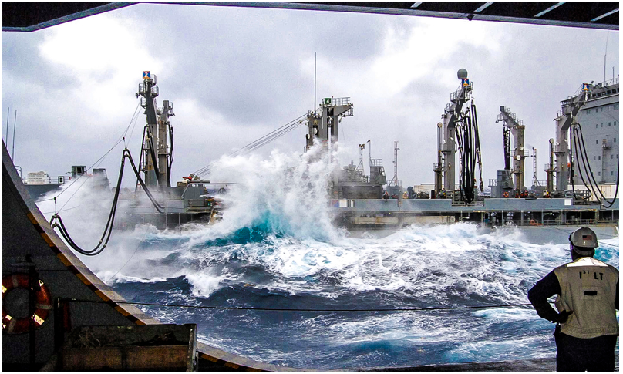
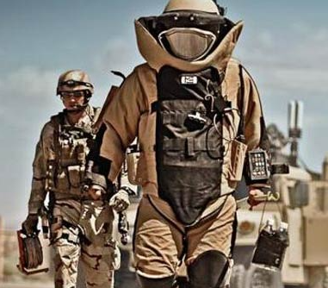
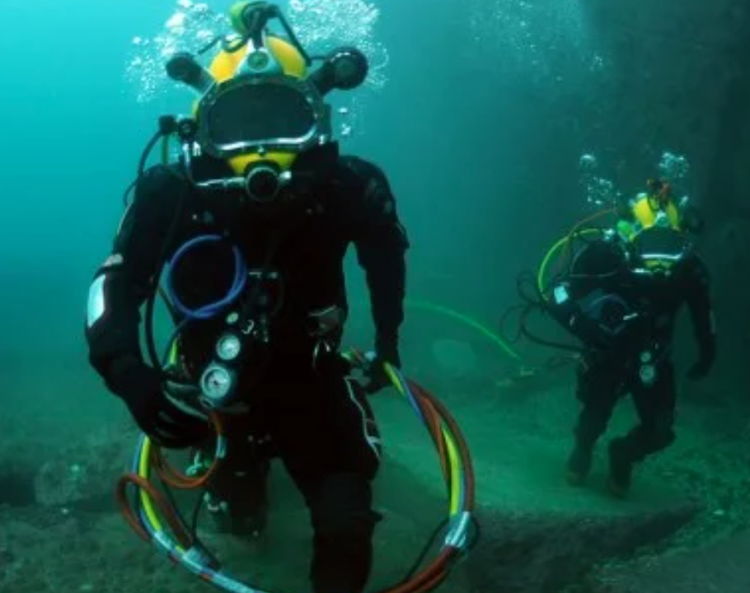
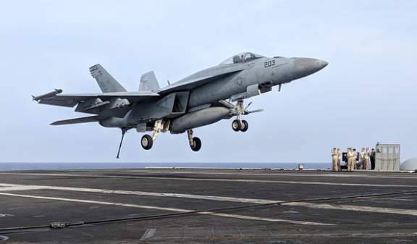
Operational Risk Management
Operational Risk Management (ORM) is a “decision-making tool used by personnel at all levels to increase effectiveness by identifying, assessing, and managing risks” (OPNAVINST 3500.39 Series)
The Navy and the military at large is NOT aiming for NO risk, rather it’s seeks to minimize risk to “acceptable levels.”

Slide 13
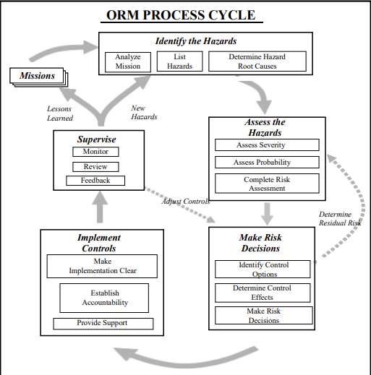
Operational Risk Management
ORM Process
Identify Hazard
Assess Hazard
Make RISK Decision
Implement Controls
Supervise
Levels of ORM
In-Depth
Deliberate
Time Critical
Notes:
In-depth. The in-depth level refers to situations when time is not a limiting factor and the “right” answer is required for a successful mission or task. Thorough research and analysis of available data, use of diagrams and analysis tools, and formal testing or long term tracking of associated hazards are some of the tools used at this level. Other examples of application of ORM at the in-depth level include, but are not limited to: long term planning of complex or contingency operations; technical standards and system hazard management applied in engineering design during acquisition and introduction of new equipment and systems; development of tactics and training curricula; and major system overhaul or repair.
b. Deliberate. The deliberate level refers to situations when there is ample time to apply the ORM process to the detailed planning to obtain the “best” answer required of a mission or task. At this level, the planning primarily uses experienced personnel and brainstorming and is most effective when done in a group. The Navy planning process is a good example of ORM application integrated at this level. Other examples include: planning of unit missions, tasks, or events; review of SOPs, maintenance or training procedures; recreational activities; and the development of damage control and emergency response plans.
c. Time Critical. This is the level at which personnel operate on a daily basis both on- and off-duty. The time critical level is best described as being at the point of commencing or during execution of a mission or task. At this level there is little or no time to make a plan. An on-therun mental or verbal assessment of the new, changed, or changing situation is the best one can do. Time is limited in this situation, so the application of the five-step process has proven impractical and ineffective. The Navy has adopted the ABCD Model, enclosure (2), to facilitate use of ORM at the time critical level.

Slide 14
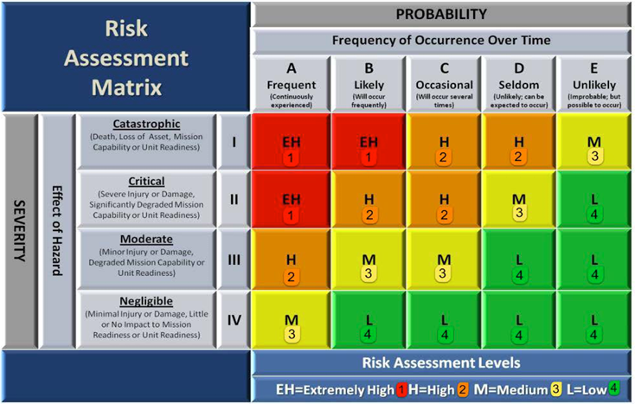
Deliberate ORM

Slide 15
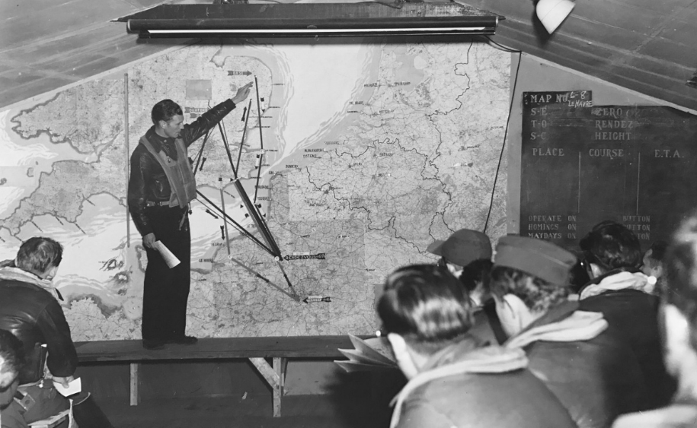
Deliberate ORM
Deliberate ORM is used in situations when there is ample time (vice not a factor for In-Depth) to apply the ORM process to detailed planning for a mission or task.
This ORM is best done in groups and with experienced personnel maximize effectiveness. Such examples used in the U.S. Navy include:
Navigation Briefs
Unit Mission Planning
Emergency Response Plans

Slide 16
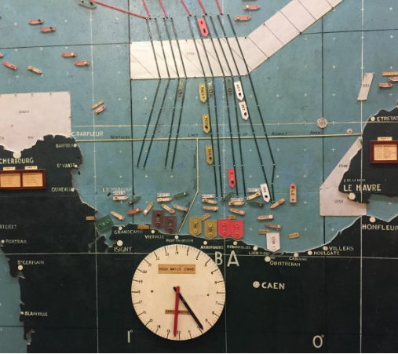
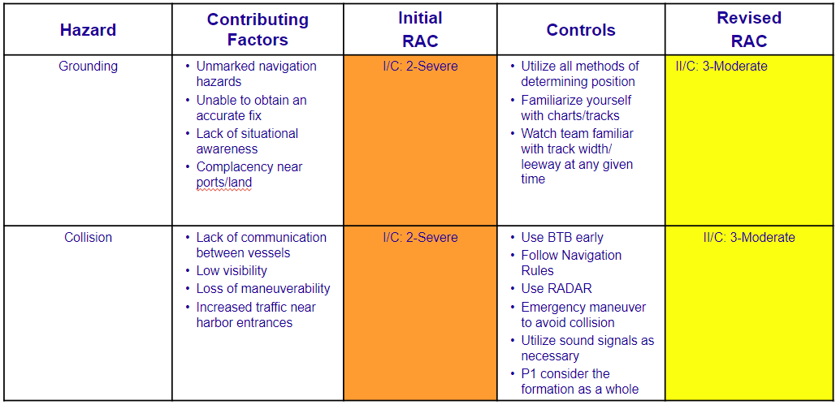
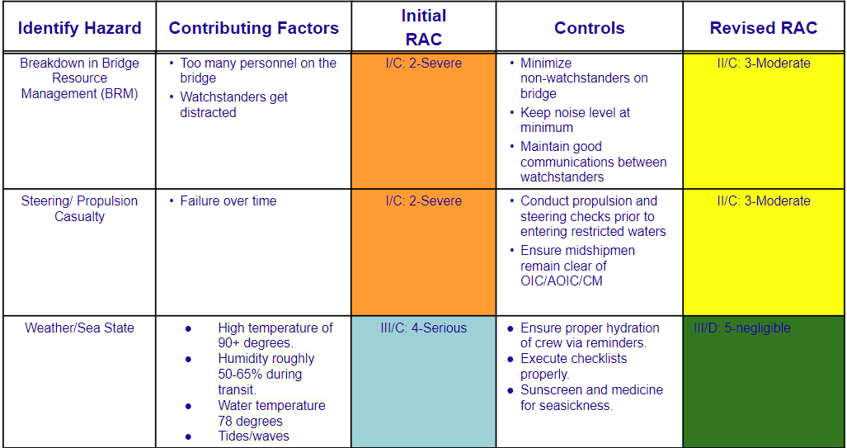
Deliberate ORM Example

Slide 17
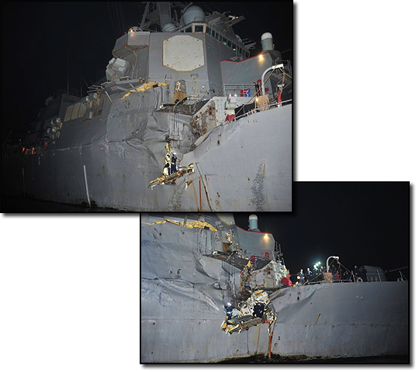
Time Critical (TCRM)
Time Critical level begins at the point of commencing or during execution of mission or task.
There is little or NO time to make a plan due to new, changed, or changing situation.
The ORM five-step process deemed ineffective.
Time Critical ABCD model:
A: Assess the situation
B: Balance resources
C: Communicate to others
D: Do and Debrief the event

Slide 18
What is an Error Chain?
From “Shipboard Bridge Resource Management” by Michael R. Adams:
“Rarely is a mishap attributable to one single catastrophic cause. Instead, there is almost always a series of errors of omission (things not done that should have been done) and/or errors of commission (things done that should not have been done) that combine to create catastrophe.”
When the individual errors become linked together, it becomes an Error Chain.
Successful teams observing good BRM can break/trap the “Chain.” This does NOT means they are faultless. Rather, it is being aware and confronting mistakes that appear that violate BRM principles.

Slide 19
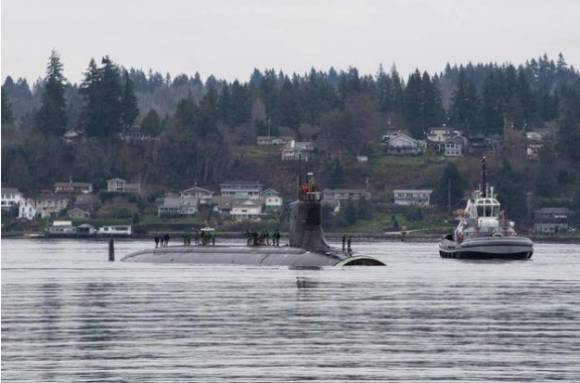
What is the Error Chain?
CONNECTICUT (SSN 22) striking of submerged object in 7th Fleet AOR:
“On 2 October 2021, CONNECTICUT grounded on an uncharted bathymetric feature while operating submerged in a poorly surveyed area in international waters. This mishap was preventable. It resulted from an accumulation of errors and omissions in navigation planning, watchteam execution, and risk management that fell far below U.S. Navy standards” – Command Investigation.

Slide 20
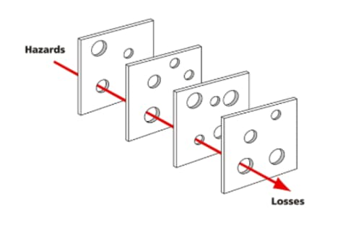
Swiss Cheese Model
The Swiss Cheese Model is another way we illustrate incidents vice just “links in a chain.”
Each error is a hole in a block of swiss cheese. Line up the holes the right way and an incident happens.
Close one of the holes and an incident does not occur.

Slide 21
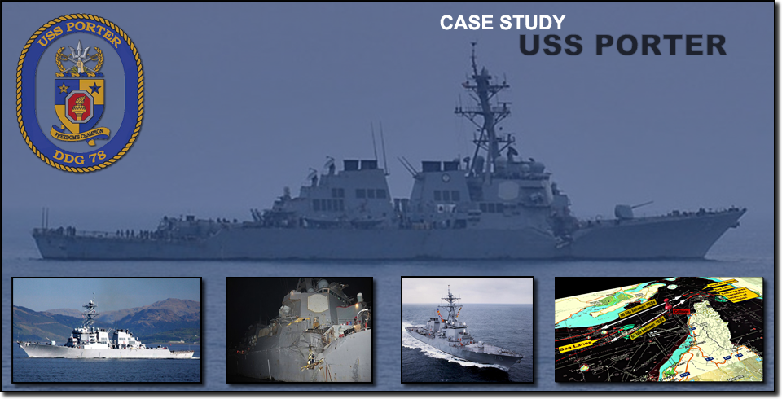
USS PORTER (DDG 78)

Slide 22
Background Information
Type: Collision
Date: 12 Aug 2012
Time: 0053 (night)
Location: Vicinity of the Strait of Hormuz

Slide 23
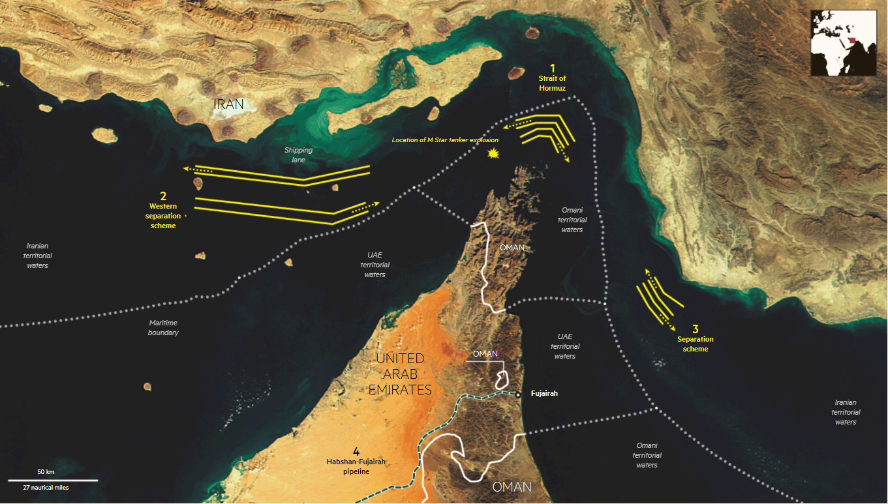

Slide 24
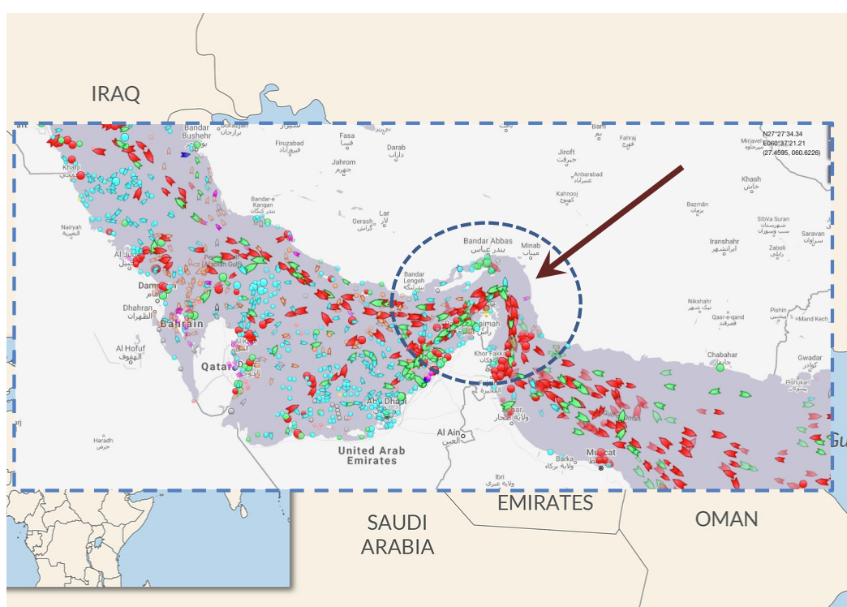

Slide 25
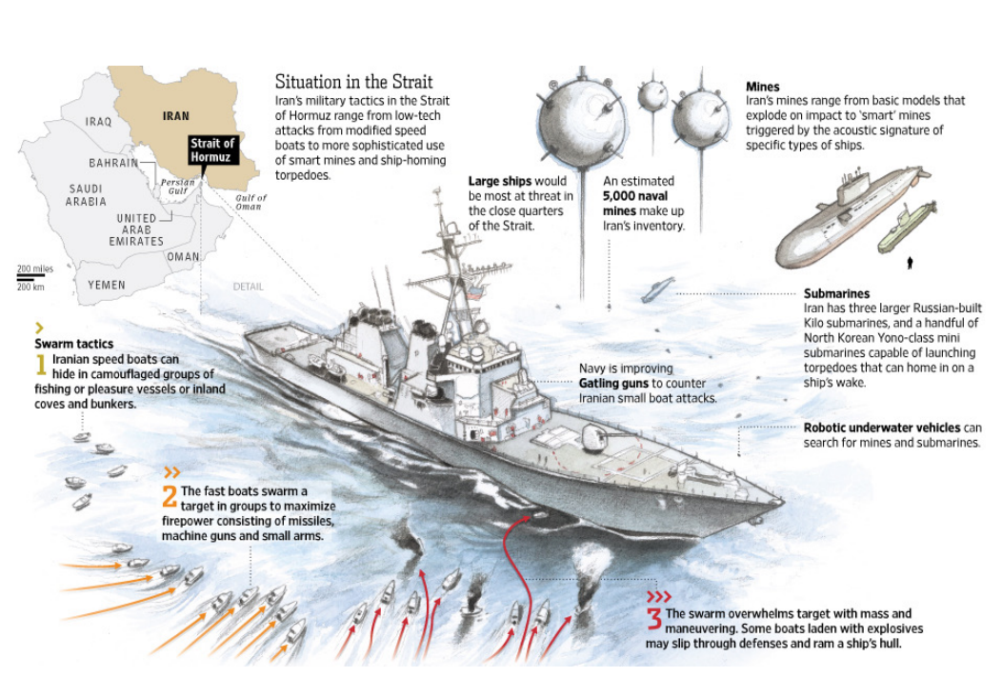
Small Boat, Swarm Tactics - https://www.youtube.com/watch?v=CkbS4BQxTgg

Slide 26
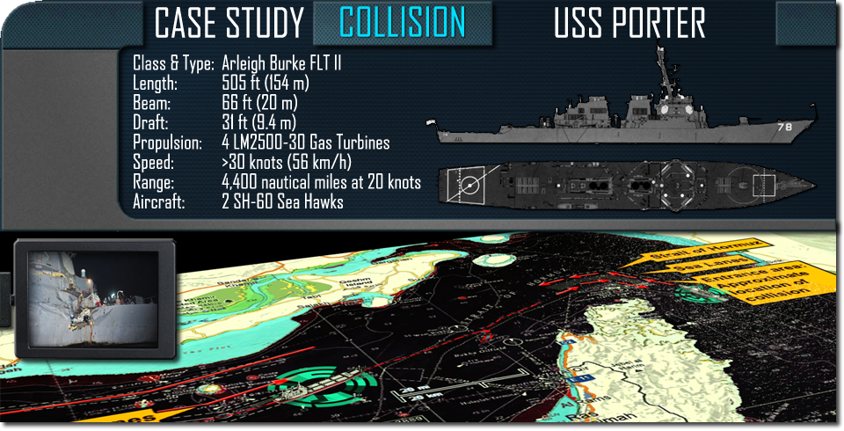
Ship Characteristics

Slide 27
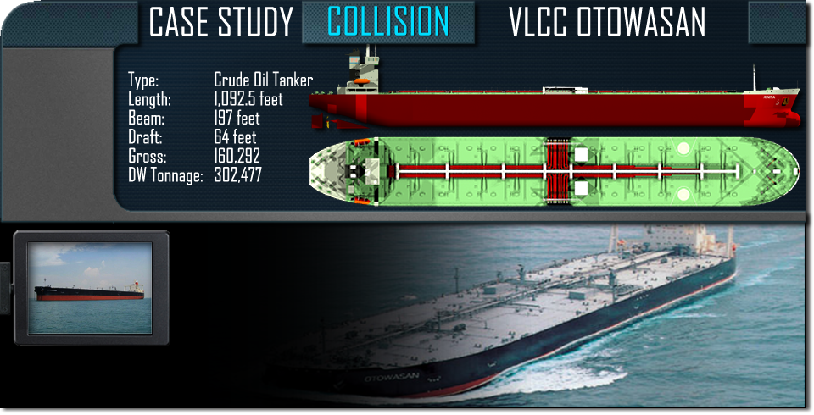
Ship Characteristics

Slide 28
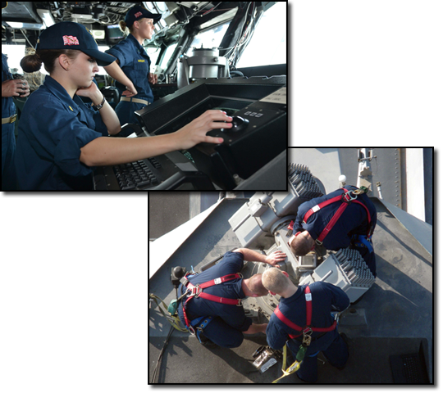
Equipment
Out Of Commision (OOC)
OSS
DDRT
Available
SPS-64 (ARPA)
SPS-67 (ARPA)
SPY-1D (FC RADAR)
WSN-5 (Gyro & INS)
WRN-6 (GPS)

Slide 29
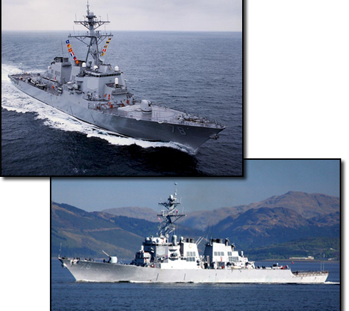
Sequence of Events
11 Aug 2012
1600: OPS/INTEL Brief
1600: Strait of Hormuz Brief
2100: Strait of Hormuz detail set
2100: Modified Zebra set
2116: Engineering full power configuration set

Slide 30
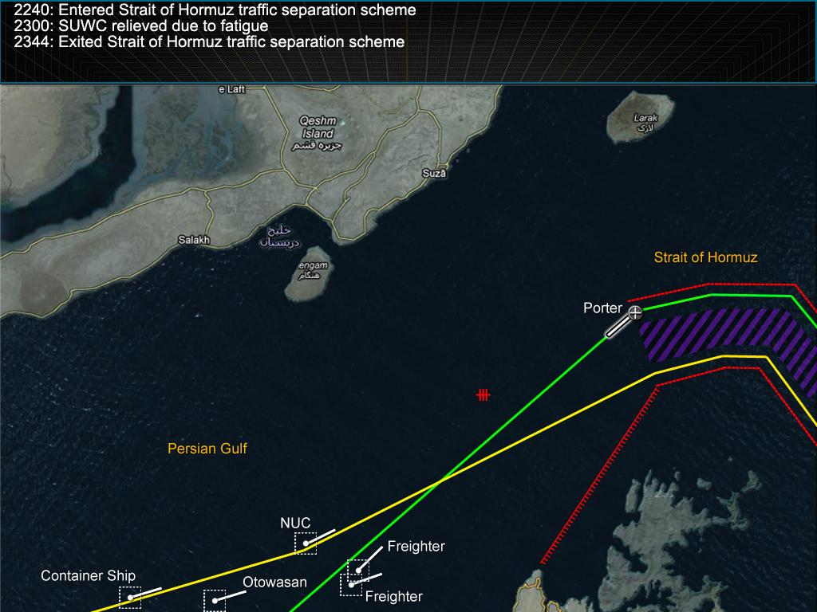

Slide 31
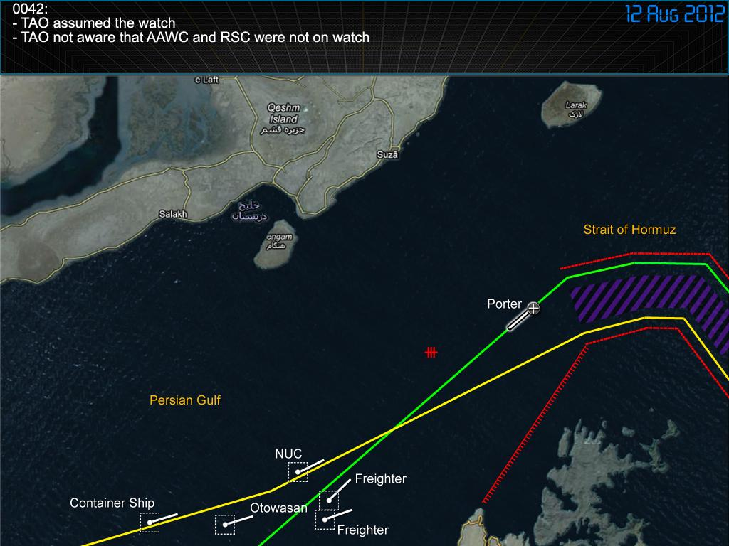

Slide 32
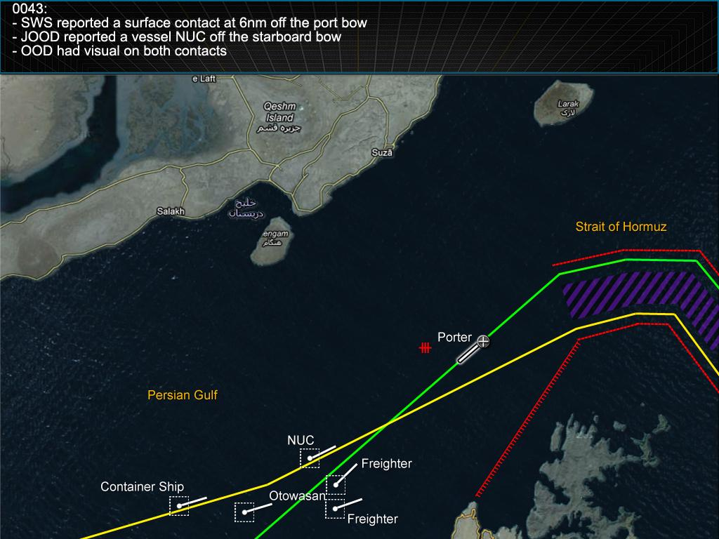

Slide 33
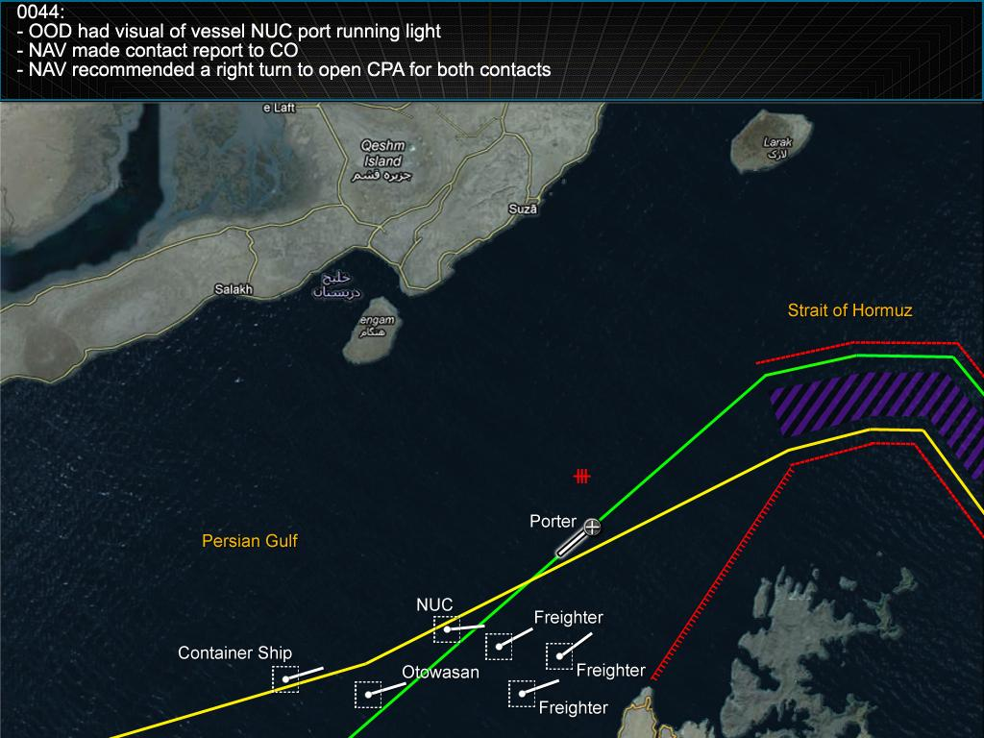

Slide 34
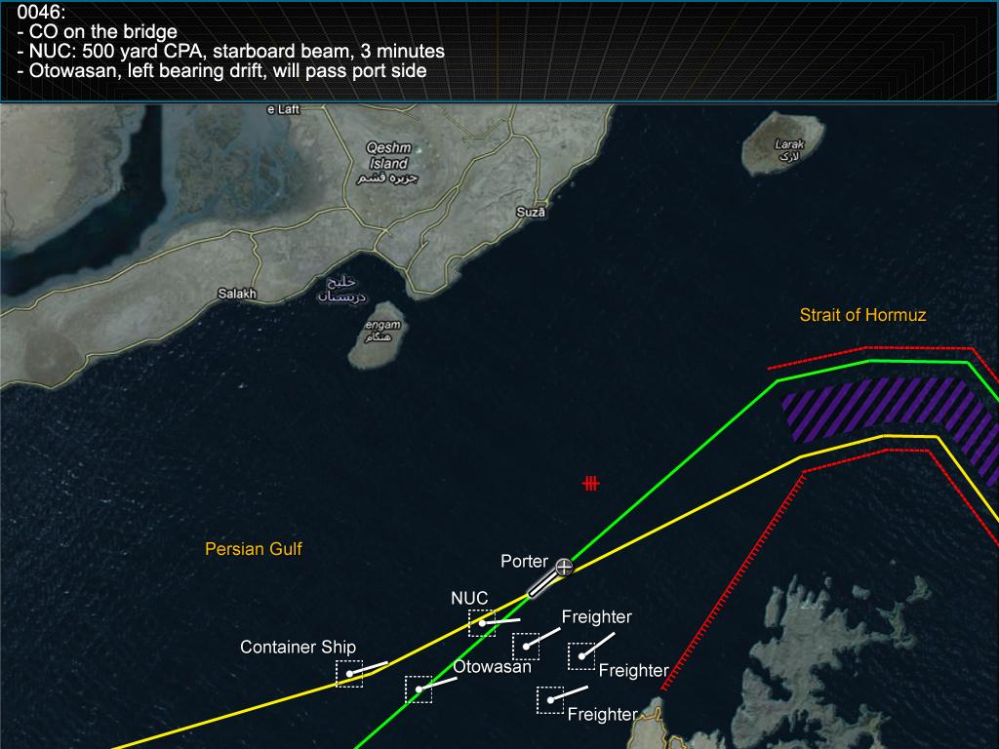

Slide 35


Slide 36


Slide 37
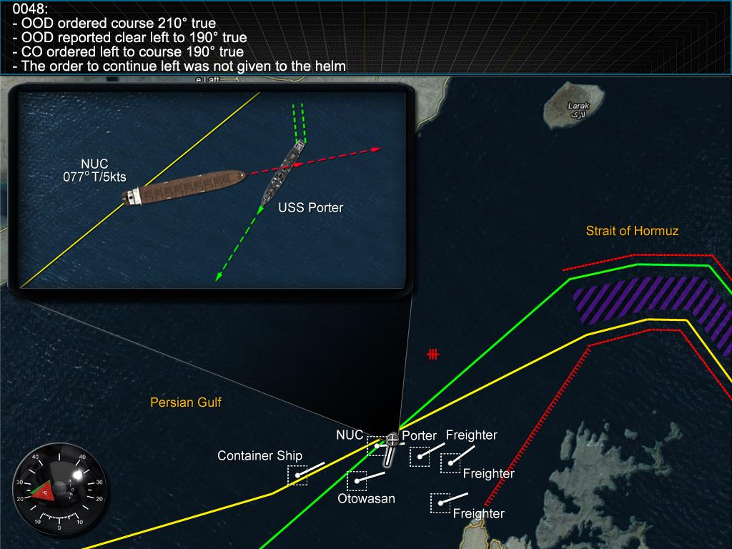

Slide 38
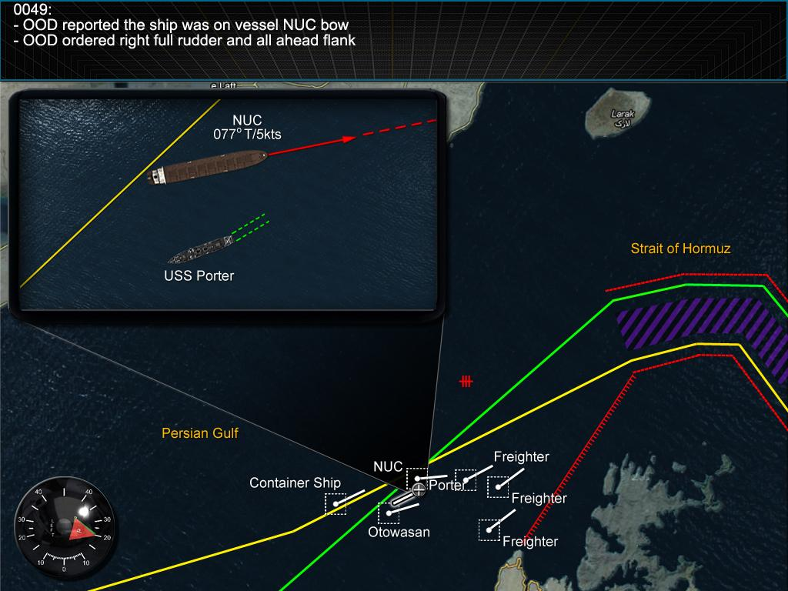

Slide 39
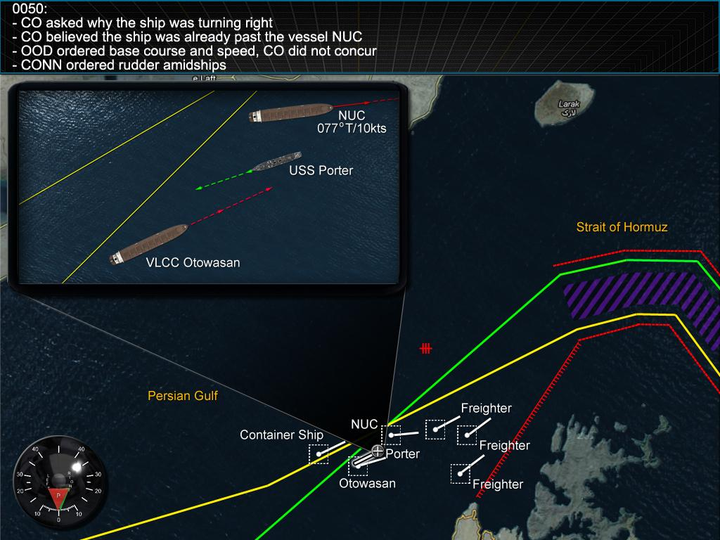

Slide 40
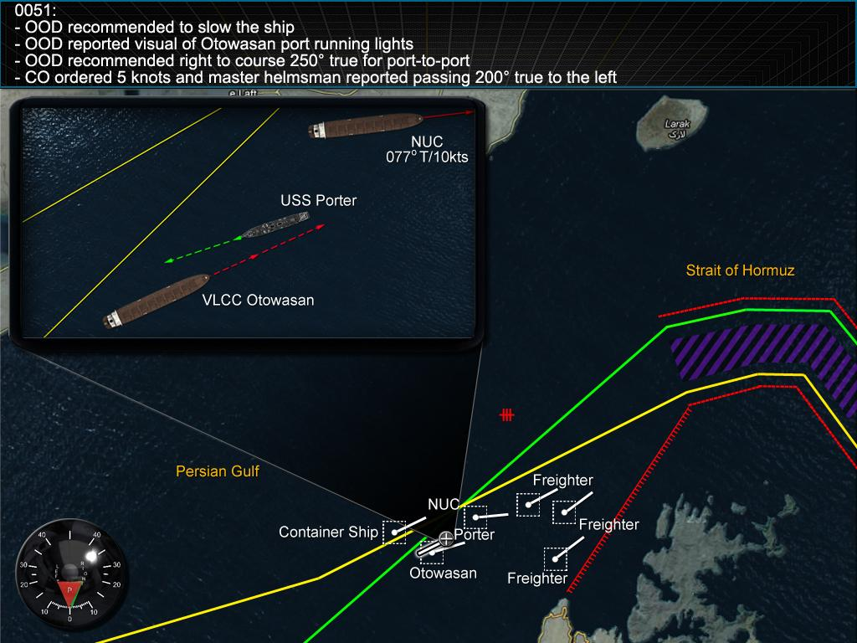

Slide 41
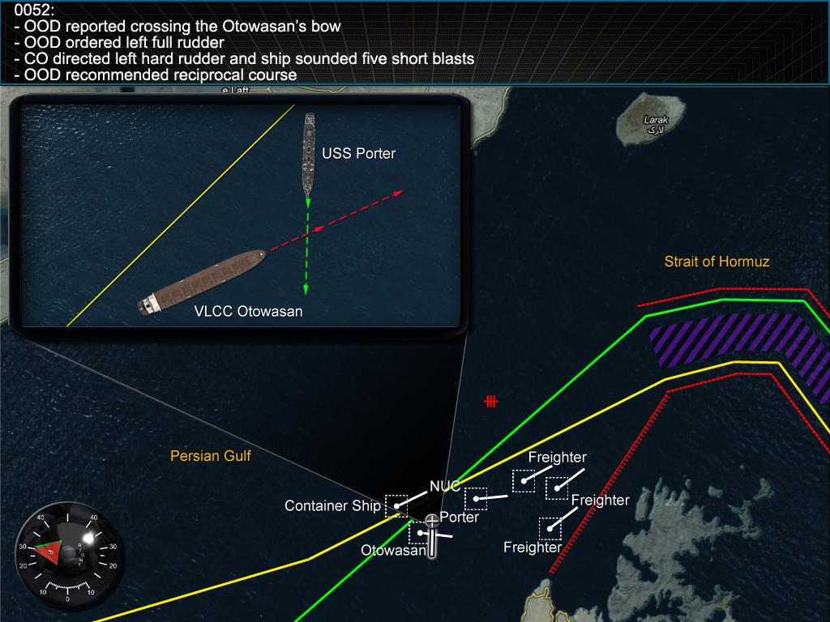

Slide 42
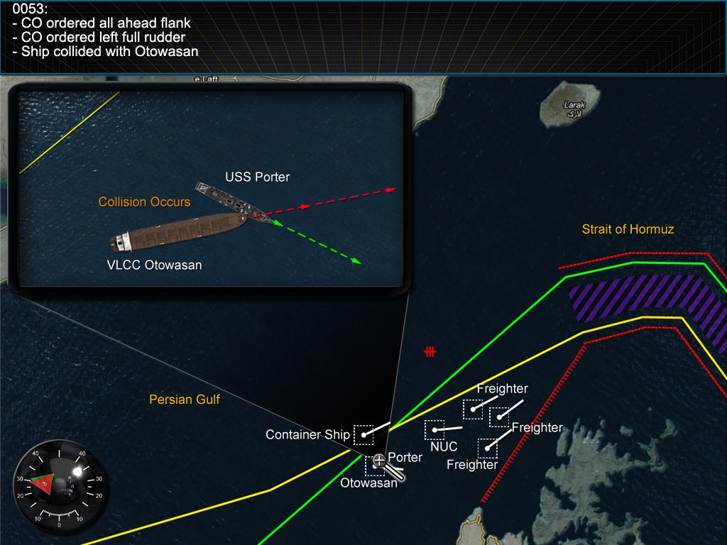

Slide 43
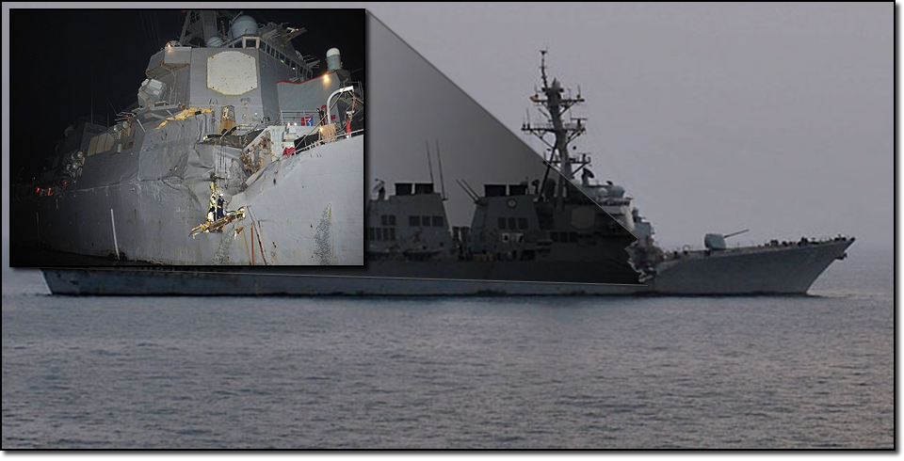
Collision Damage
https://www.youtube.com/watch?v=P-coEUKd_FE

Slide 44
Bridge Audio
https://soundcloud.com/naval-institute/bridge-audio-from-the-aug-12-2012-collision-of-uss-porter-ddg-78

Slide 45
Human Factors

Slide 46
Human Factors Discussion
What were the human factors that contributed to the mishap?
Qualification factors?
Procedural errors/omissions factors?
Effective supervision factors?
Training factors?
What methods could have helped mitigate the human factors that contributed to the mishap?

Slide 47
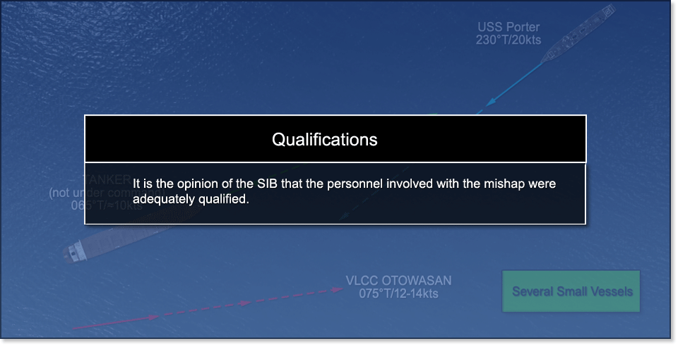
SIB Findings

Slide 48
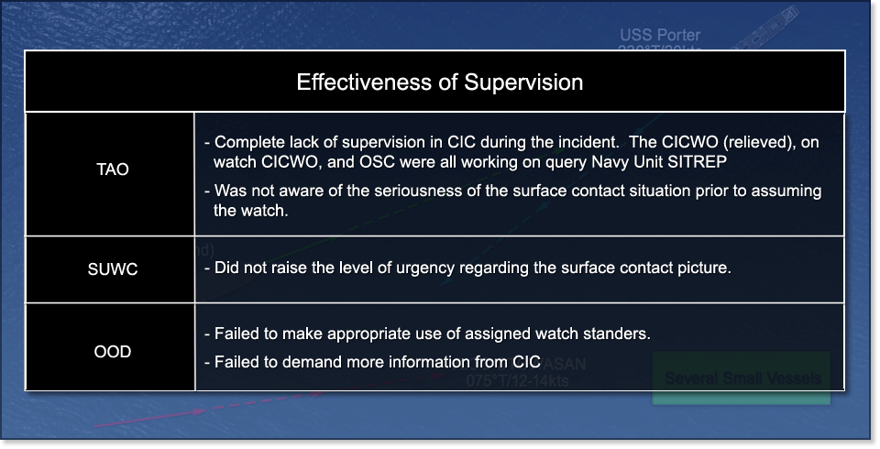
SIB Findings

Slide 49
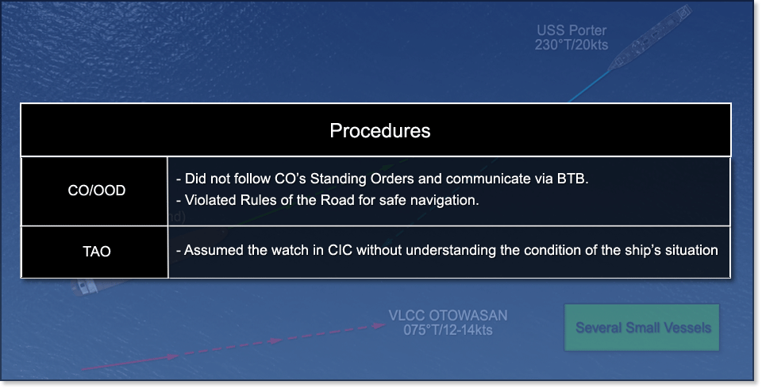
SIB Findings

Slide 50

SIB Findings

Slide 51
Post Discussion
Did your answer change after seeing SIB fact and opinion?
Where do you agree or disagree with SIB?
Where were the SIB opinions incorrect?
Where were the SIB opinions correct?
What additional Human Factors did the SIB miss?

Slide 52
Error Chain

Slide 53
Error Chain Discussion
How do you identify the beginning of the Error Chain?
Who is responsible for identifying the beginning of the Error Chain?
What was the beginning of the Error Chain?

Slide 54

Prior to Day of Mishap
CO did not date the watch bill
SUWC was relieved due to fatigue
Equipment OOC
OSS
DDRT

Slide 55
Day of Mishap
0042: TAO assumed the watch in CIC
Unaware of the watch bill changes
Unaware of the surface contact picture
0043: OOD sighted two vessels
Lights of a Vessel Not Under Command (NUC) off the starboard bow
Lights of a Foreign tanker off the port bow
OOD asked bridge team for contact management support (BRM at work).
0044: NAV calls the CO is his stateroom
Delivers a contact report and recommends to alter course to starboard to open CPA with both.

Slide 56

Day of Mishap
0046: CO on the Bridge
0047: OOD recommended to slow the ship but was over-ruled by the CO
0048: The CO directed left to course 190 but the order was not given to the master helm

Slide 57

Day of Mishap
0050:
CO believed vessel NUC was past and opening
CONN ordered right full rudder
OOD explained he was “kicking” the stern away from the vessel NUC

Slide 58
Day of Mishap
0051:
The OOD recommended to slow the ship
CO directed to slow to 5 knots
OOD reported port running lights on Otowasan
OOD requested to come right to course 250° true

Slide 59

Day of Mishap
0052:
The OOD reported foreign tanker had a port aspect and was crossing the bow.
0053:
The CO ordered all ahead flank and left full rudder
Collision occurs between Porter and Otowasan

Slide 60
Post Discussion
Did your answer change after seeing SIB fact and opinion?
Where do you agree or disagree with the SIB?
Where were the SIB opinions incorrect?
Where were the SIB opinions correct?
What additional Error Chain items were missed by the SIB?
Which of these Error Chain items, if performed correctly, could have broken the Error Chain and prevented the mishap?

Slide 61
Situational Awareness

Slide 62
SA Discussion
Where were the failures in Situational Awareness (SA) for:
Senior leadership?
CIC watch team?
Bridge watch team?
What could senior leadership have done to improve SA?

Slide 63

Commanding Officer

Slide 64

Senior Leadership

Slide 65

Bridge Team

Slide 66

Bridge Team

Slide 67

CIC

Slide 68

CIC

Slide 69
Post Discussion
Did your answer change after seeing SIB fact and opinion?
Where do you agree or disagree with the SIB?
Where were SIB opinions incorrect?
Where were SIB opinions correct?
What additional SA items did the SIB miss?
Was there early detection of each vessel and was action taken early and CORRECTLY?
What kind of Rules of the Road situations developed?
Crossing? Head-On? Hierachy?

Slide 70

Post Discussion: COLREGs

Slide 71
Operational Risk Management

Slide 72
ORM Discussion
What could have been done to make ORM more effective?
Who is responsible for ORM?
Who is responsible for conducting Time Critical Risk Management (TCRM)?

Slide 73

Deliberate ORM

Slide 74

TCRM

Slide 75
Post Discussion
What is the value of ORM
Who is responsible for ORM?
Who is responsible for TCRM?
If TCRM had been performed, would it have helped prevent this mishap? How and Why?

Slide 76
Final Thoughts
“This case demonstrates how easily disaster can be avoided by strict compliance with the nautical Rules of the Road and how command climate can restrict decision-making on the bridge, which costs valuable time when every second counts” – CAPT Steve Coughlin, USN (ret.)
“A common trait among surface warriors (SWOs) is that we tend to learn (or stumble into) the same lessons over and over again. Occasionally a sanitized report will come from the Naval Safety Center on an actual collision or grounding, and these are useful to be sure, but it is no secret that for every class A mishap there are several smaller close calls that, if captured, could provide lessons to help the rest of us prevent them” – CAPT John Pordle, USN (ret.)
“For this investigator, the experience brought back chilling memories of a few very close calls in my own career, left me with a renewed appreciation for the unique challenges of the maritime profession, and drove home the very personal and human weight of responsibility that comes with command at sea” – Leading JAG Investigator, PORTER Incident

Slide 77

USS FITZGERALD
Notes:
https://features.propublica.org/navy-accidents/uss-fitzgerald-destroyer-crash-crystal/
https://warontherocks.com/2017/06/how-could-this-happen-the-fitzgerald-the-u-s-navy-and-collisions-at-sea/

Slide 78

HNoMS HELGE INSTAD
Notes:
https://www.youtube.com/watch?v=1zsp-lHm_JM

Slide 79
Enabling Objectives
1 – IDENTIFY human factors that likely contribute to marine mishaps and methods to mitigate these factors. 2- APPLY applicable rules outlined in the Amalgamated International & U.S. Inland Navigation Rules which were & were not followed in the case study. https://www.navcen.uscg.gov/?pageName=NavRulesAmalgamated#Rule%2015 3 - DEFINE the error chain. 4 - DISCUSS how effective ORM could have mitigated the mishap. 5 - DETERMINE the Error Chain and the actions, decisions, and events that allowed a given mishap to develop. 6 - DISCUSS solutions that could prevent Error Chain progression. 7 - DISCUSS ways the bridge watch team can mitigate Error Chain progression from the bridge. 8 - APPLY the Error Chain Model to a Case Study. 9 - UTILIZE concepts learned in the course to determine mitigating factors to avoid an incident at sea.
SEANAV I United States Naval Academy
NN220 – Fundamentals of Navigation
Operations Officer I HMS PROTECTOR A173 I The Ice Patrol Ship

Slide 80

Questions?
SEANAV I United States Naval Academy
NN220 – Fundamentals of Navigation
Operations Officer I HMS PROTECTOR A173 I The Ice Patrol Ship

